Slide 1

Crowdsourcing Codebook Enhancements A DDI-based Approach
FCSM, December 2nd 2015
Lars Vilhuber (Cornell University)
Benjamin Perry (Cornell University)
Venkata Kambhampaty (Cornell University)
Kyle Brumsted (McGill University)
William Block (Cornell University)
Notes:
Abstract:
Recent years have shown the power of user-sourced information evidenced by the success of Wikipedia and its many emulators. Agencies on the other hand publish metadata on their data products, but have little opportunity to get structured feedback on that metadata (codebooks) from their users. Creating and augmenting metadata is a labor-intensive endeavor. Harnessing collective knowledge from actual data users can supplement officially generated metadata. As part of our Comprehensive Extensible Data Documentation and Access Repository (CED²AR) infrastructure, we demonstrate a prototype of crowdsourced metadata (codebooks), using DDI-C and supplemental XML. The system allows for any number of network connected instances (web or desktop deployments) of the CED²AR DDI editor to concurrently create and modify metadata. The backend transparently handles changes, and frontend has the ability to separate official edits (by designated curators of the data and the metadata) from crowd-sourced content. Features of the software allow official curators to merge in select enhancements into revisions of official documentation. CED²AR ingests and publishes widely-used DDI metadata standards, and can thus easily augment existing metadata publishing systems. Using standards-compliant ingest and publication methods, our proposed crowd-sourced metadata system can greatly enhance user acceptance of documentation, user-engagement in the documentation process, and reduce agency costs while improving the quality of data documentation. This development is part of the NSF-Census Research Network node at Cornell University.

Slide 2
Issues
Data curators (Agencies) lack a mechanism to obtain structured feedback for their metadata
Metadata standards for the social science community are difficult to navigate, even with complex tools
Metadata curation is a labor intensive process

Slide 3
Our Approach
Provide easy-to-use tools and interfaces to structured metadata
Rely on open standards, namely the Data Documentation Initiative (DDI) schema
Build infrastructure that enables data curators to leverage community-driven input to official documentation

Slide 4



How?
CED²AR
The Comprehensive Extensible Data Documentation and Access Repository
Notes:
Pronounced /ˈsidər/, like a cedar tree

Slide 5
What is CED²AR?
Metadata curation software
Designed for documenting existing datasets
Funded by NSF grant #1131848
Online at www2.ncrn.cornell.edu/ced2ar-web

Slide 6
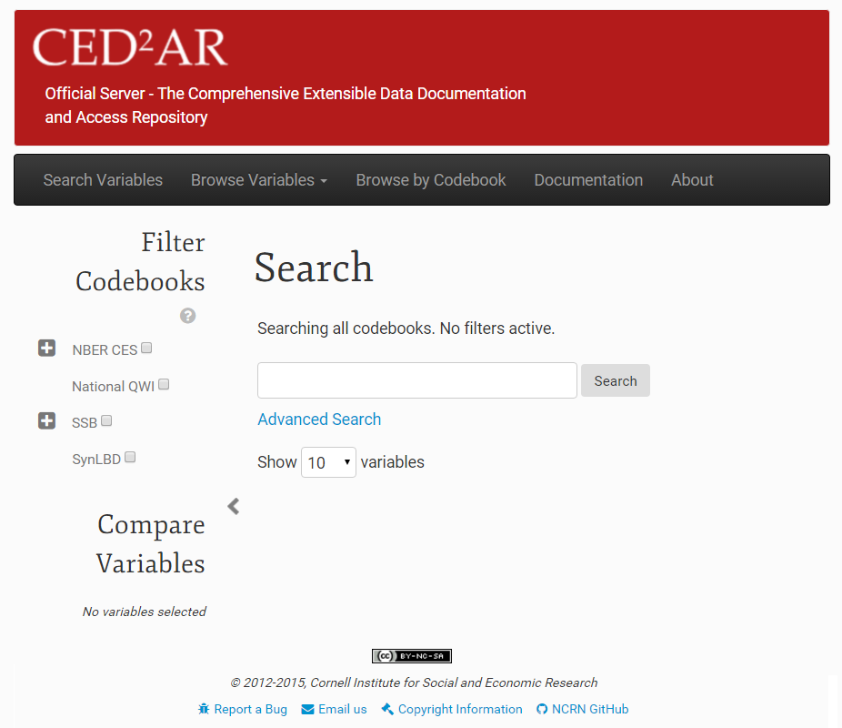
What is CED²AR?
Notes:
Web based, open source, and free for non-commercial use

Slide 7
Basic Information Flow
Staging Area
Public Facing
Official
Metadata
Datasets
Internal
Metadata
User switches
Crowdsourced
Metadata
7
Notes:
Instances of CED²AR are networked together in a distributed system – no centralized repository Three key instances exist for the curation process
An internal server to stage metadata
An official server to publish metadata
A crowdedsourced, or community server open to modifications
Metadata moves between all three instances

Slide 8
Basic Information Flow
Staging Area
Public Facing
Official
Metadata
Datasets
Internal
Metadata
User switches
Crowdsourced
Metadata
8

Slide 9
Internal Processing
1. Creation of skeletal metadata
Assuming data is already curated
Converting data into standardized metadata
Tools included (for SAS, Stata, SPSS, CSV), not discussed here [appendix slides]
2. Hand editing and subsetting
Adding verbose descriptions
Applying disclosure limitation

Slide 10
Internal Processing
Simple editing interface
Web-based, with limited rich text features
Math allowed (LaTeX)
Feedback
Completeness of codebook?
Without technical jargon!
Can be tuned

Slide 11
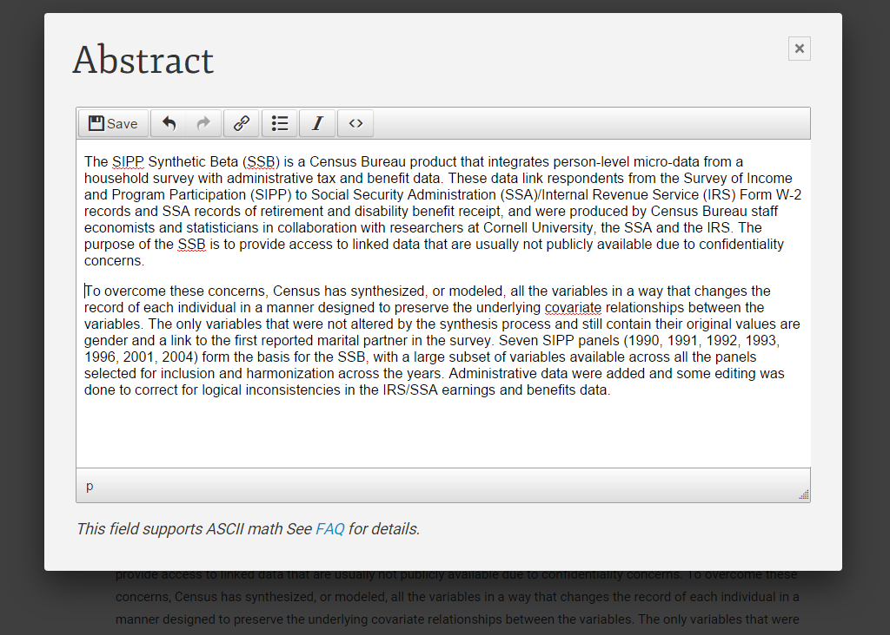
Internal Processing: Hand Editing

Slide 12
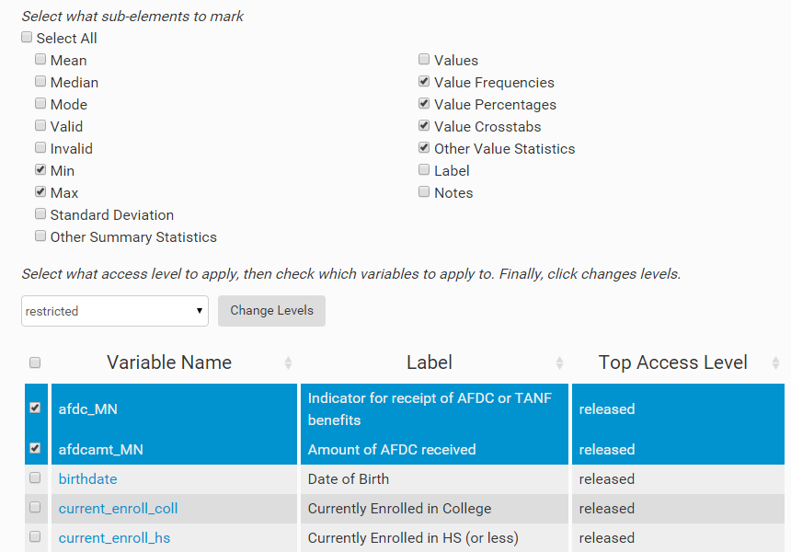
Internal Processing: Access Control
Marking elements with different restrictions
Notes:
Gives users the ability omit specific elements such as summary statistics, and frequencies

Slide 13
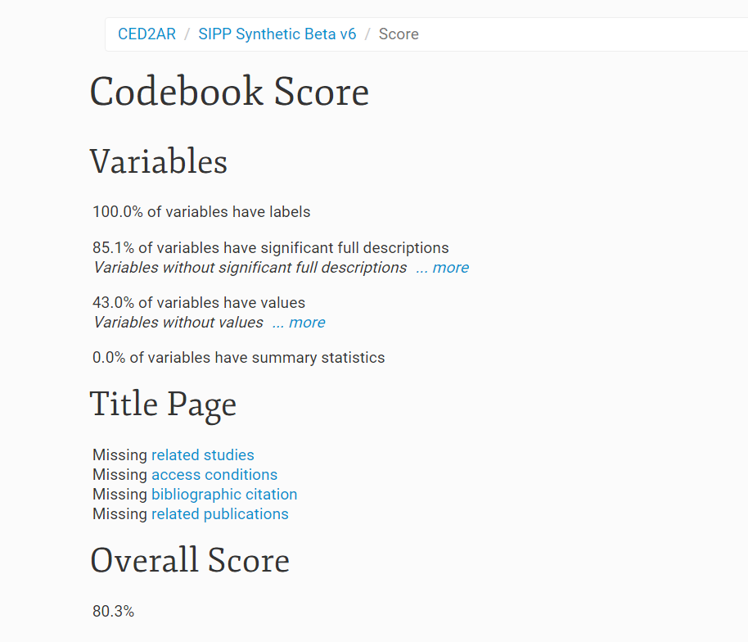
Internal Processing: Scoring
Provide feedback to improve sparse documentation

Slide 14
Workflow control
Ability to view additions/subtractions
Between versions
Between crowd-sourced information and official information
Ability to control access
Editing versus viewing
Authentication and reputation

Slide 15
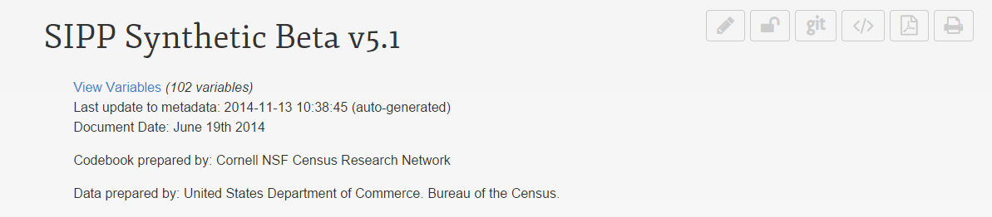
Versioning
Uses Git, a distributed version control system
Every aspect of the system is configurable
Scheduled tasks check for changes
Once changes exceed threshold, they are pushed
Remote instances pull changes on demand
Notes:
All instance use versioning!

Slide 16
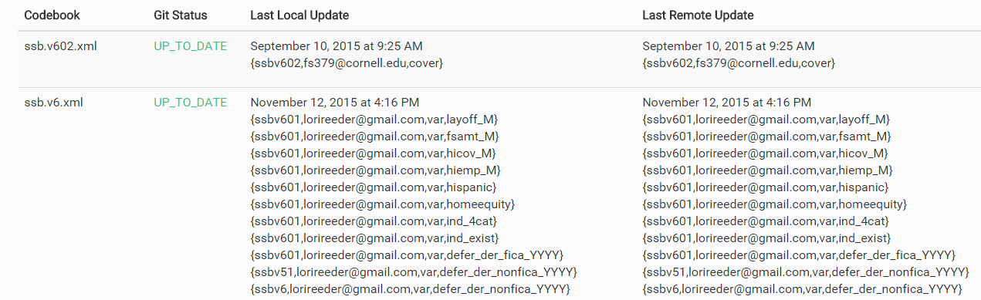
Combining Knowledge
Viewing changes made
Notes:
Managing a distributed network of metadata

Slide 17
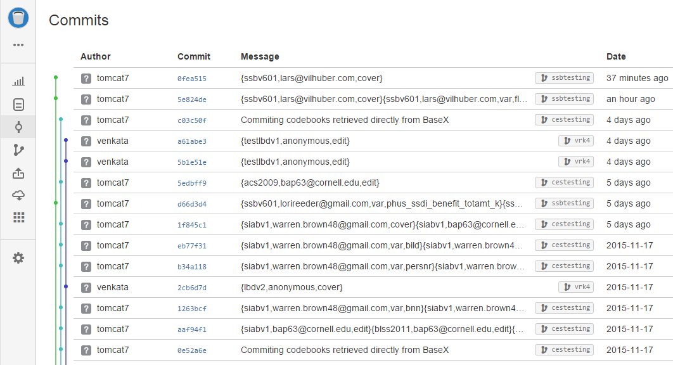
Versioning
All changes are logged externally via Git

Slide 18
Basic Information Flow
Staging Area
Public Facing
Official
Metadata
Datasets
Internal
Metadata
User switches
Crowdsourced
Metadata
18
Notes:
Public facing instances can ingest metadata from staging area on demand

Slide 19
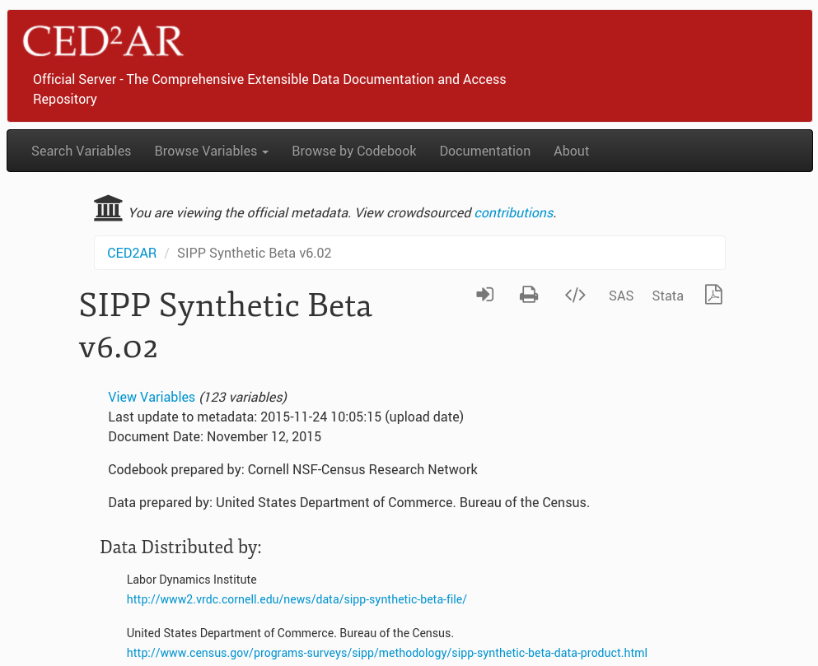
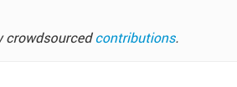
Official view

Slide 20
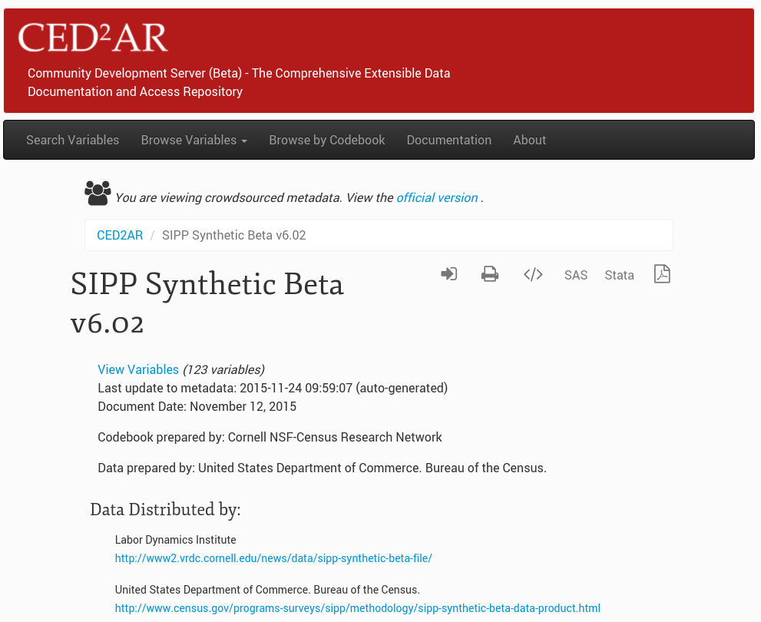

Crowdsourced view

Slide 21
Basic Information Flow
Staging Area
Public Facing
Official
Metadata
Datasets
Internal
Metadata
User switches
Crowdsourced
Metadata
21

Slide 22
Authentication and Attribution
When opening up contributions to a wide audience, how to triage between “rants” and meaningful contributions?
Use of ORCID (academic network) for authentication
Public attribution with link to (verified) academic ID is key for positive feedback (your effort is recognized) and prevention of negative contribution (your rant is traceable to you!)

Slide 23

Authentication
Supports OpenID and OAuth2
Currently using Google and ORCID with OAuth2
Developing connectors to work with additional providers
CED²AR handles identity management
Notes:
Authentication is also important internally (small-workgroup editing!)
Possible Providers:
-Office 365 via Azure Active Directory
-GitHub
-Stack Exchange
-Facebook
-LinkedIn

Slide 24
Basic Information Flow
Staging Area
Public Facing
Official
Metadata
Datasets
Internal
Metadata
User switches
Crowdsourced
Metadata
24

Slide 25
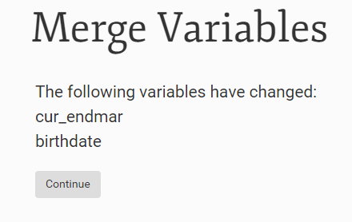
Combining Knowledge: Merging
Curators are given an interface to merge crowdsourced documentation with official

Slide 26
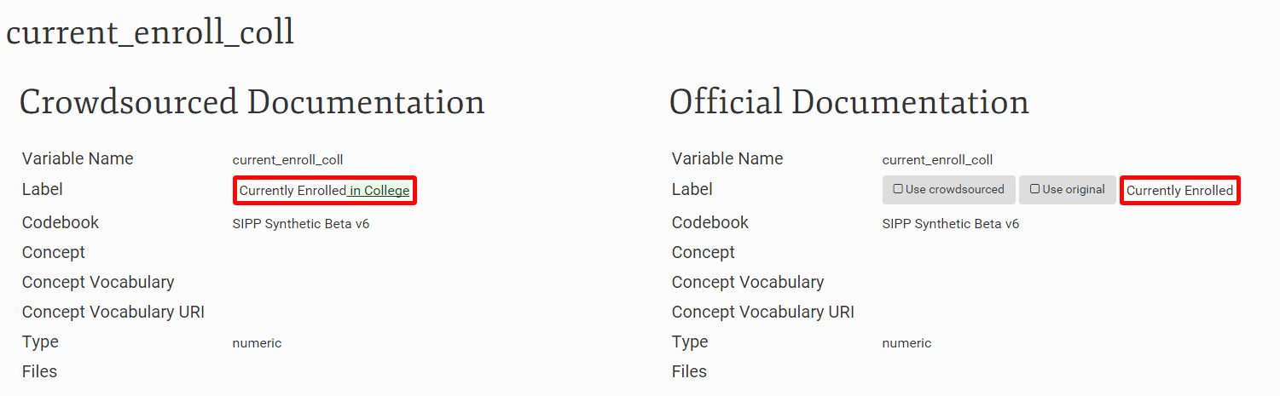
Combining Knowledge: Merging

Slide 27
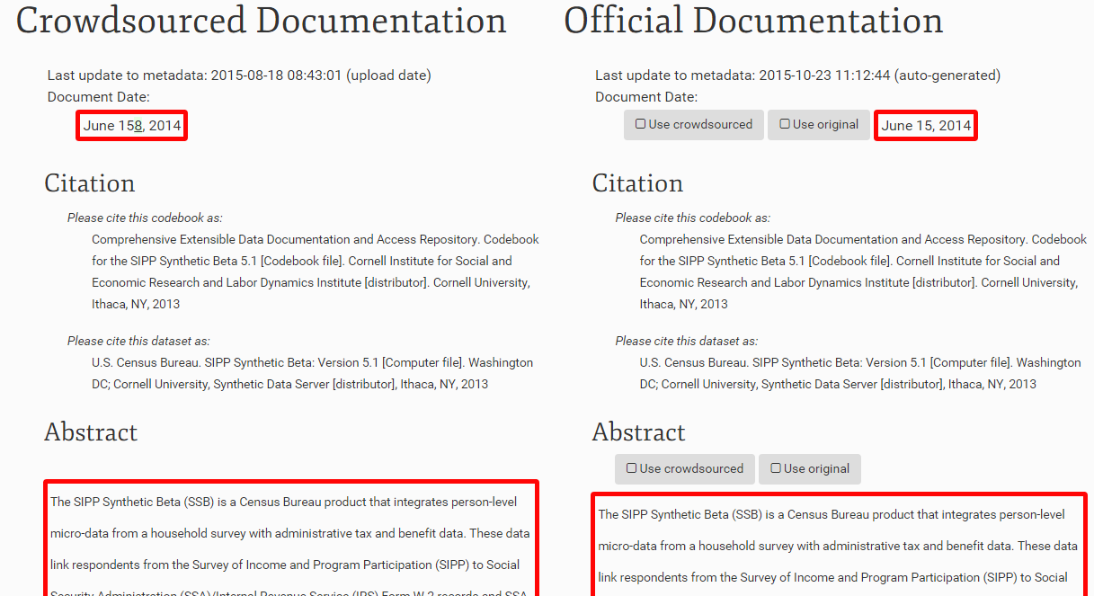
Combining Knowledge: Merging

Slide 28
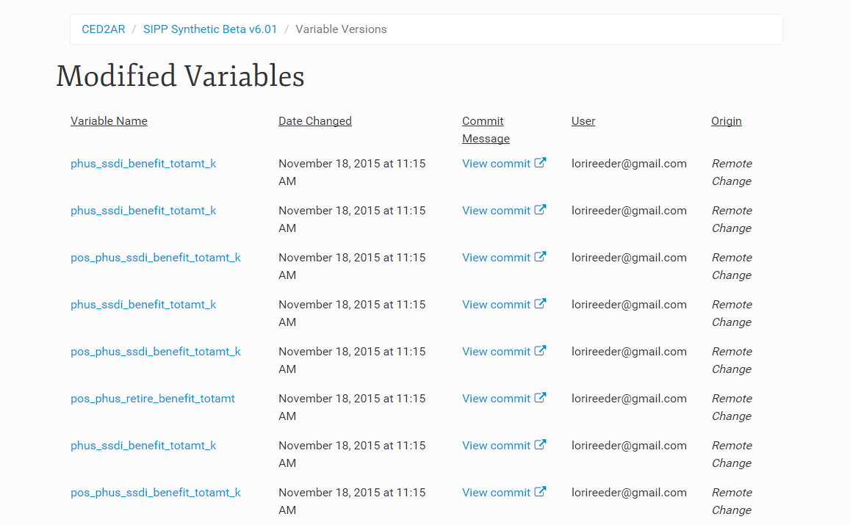
Combining Knowledge: Citations
Contributors can be tracked for each of their changes

Slide 29
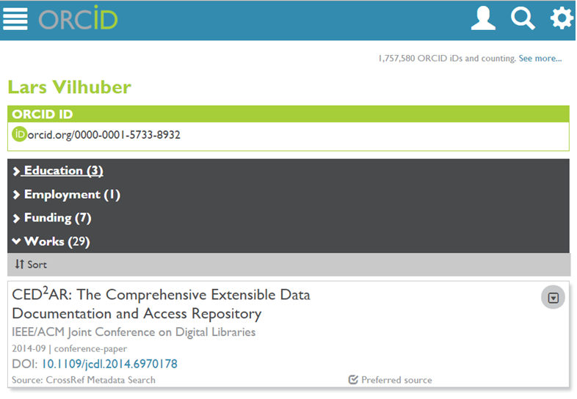
Combining Knowledge: Citations

Slide 30
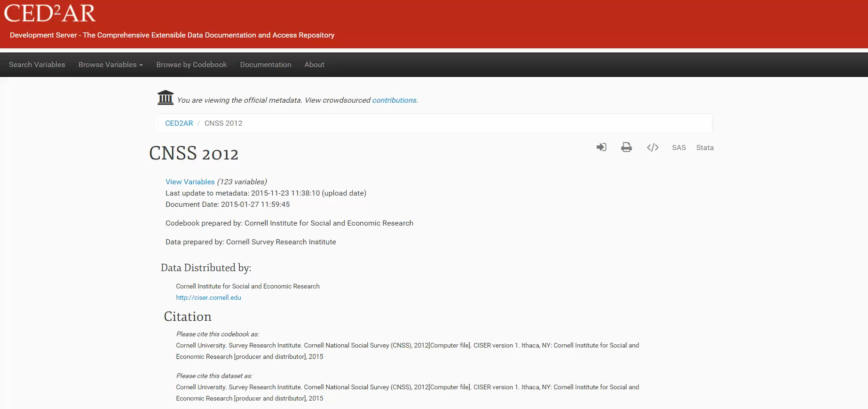
Demo
Try for yourself: http://demo.ncrn.cornell.edu

Slide 31
Future Directions
Where are we taking the project?
RePEC integrations?
Additional authentication tied to existing (document) metadata
“Claiming” user-created datasets
Entry-point to discover datasets (data provenance) and therefore need for documentation
Notes:
TODO: Add to this slide

Slide 32
Thank you!
Questions?
ced2ar-devs-l@cornell.edu

Slide 33
Extra Slides

Slide 34
Technologies Used
What technologies are used to build CED²AR?
Server: Apache/Tomcat
Databases: BaseX and Neo4j
Primary Languages/Frameworks:
Java
Spring MVC
Bootstrap, JQuery, LESS

Slide 35
Generating Metadata
Convert data to metadata
Online or offline conversion
Can start with Stata, SPSS, SAS, R, ASCII or a relational DB
We generate DDI 2.5 (codebook)

